Slide 1

Chronic kidney disease diagnostic tool
Dr. Olawole O. M M.D, Software Enginner

Slide 2
Problem Statement
Chronic kidney disease (CKD) is a condition characterized by the gradual loss of kidney function over time, usually months or years.
This damage may be caused by different factors including ageing, chronic diseases like hypertension, diabetes, drug and substance abuse etc.
The rise in the number of cases of CKD in Sub-Saharan Africa is no longer ignorable, therefore there is need to raise public awareness and also develop tools that aid clinicians and patients to make and support diagnosis and provide recommendations.
In order to tackle this challenge, I present a Chronic Kidney disease diagnostic tool, a machine learning model, a flask powered backend and a react frontend

Slide 3
The Dataset
https://www.kaggle.com/datasets/rabieelkharoua/chronic-kidney-disease-dataset-analysis/data
Appreciations and acknowledgements to Rabie El Kharoua https://www.kaggle.com/rabieelkharoua, who made this data set available on Kaggle
The dataset contains detailed health information for 1,659 patients diagnosed with Chronic Kidney Disease (CKD). The dataset includes demographic details, lifestyle factors, medical history, clinical measurements, medication usage, symptoms, quality of life scores, environmental exposures, and health behaviors.

Slide 4
Data processing
Dataset was loaded using pandas (read_csv())
Data information was checked by using Pandas methods
Info(), describe(), columns, shape.
Data integrity was checked by dropping columns for PatientID and DoctorInCharge and checking for missing values (non were found)
Feature selection was found by combining different methods (Thanks to use of LLM Claude by Anthropics, that explained the different methods and how they can be combined).
Correlation Analysis
Chi square methods
Mutual information
Recursive feature elimination
Tree Based feature importance
Variance threshold selection
Top 10 features based on frequency of choice were selected for the model training.

Slide 5
Data processing
3 Models were trained
1. Logistics Regression Model with accuracy 0.92, AUC score 0.78
2. Random Forest Classifier Model with accuracy 0.93, AUC Score 0.79
3. Xgboost Model with accuracy 0.93, AUC score 0.76
The Random Forest Classifier Model was chosen with output dumped with joblib

Slide 6
Web App
A flask backend was created with an API that loads the model and accepts a Post request for prediction The front end was developed with React, It comprises of an introductory landing page, An Assessment form page for data collection and a result page.
Demo App page: https://ckd-dignostic-tool.netlify.app/
Demo Backend API: https://ckd-diagnstic-tool-ml.onrender.com/
Github repo: https://github.com/wulzymart/ckd_diagnstic_tool_ml

Slide 7
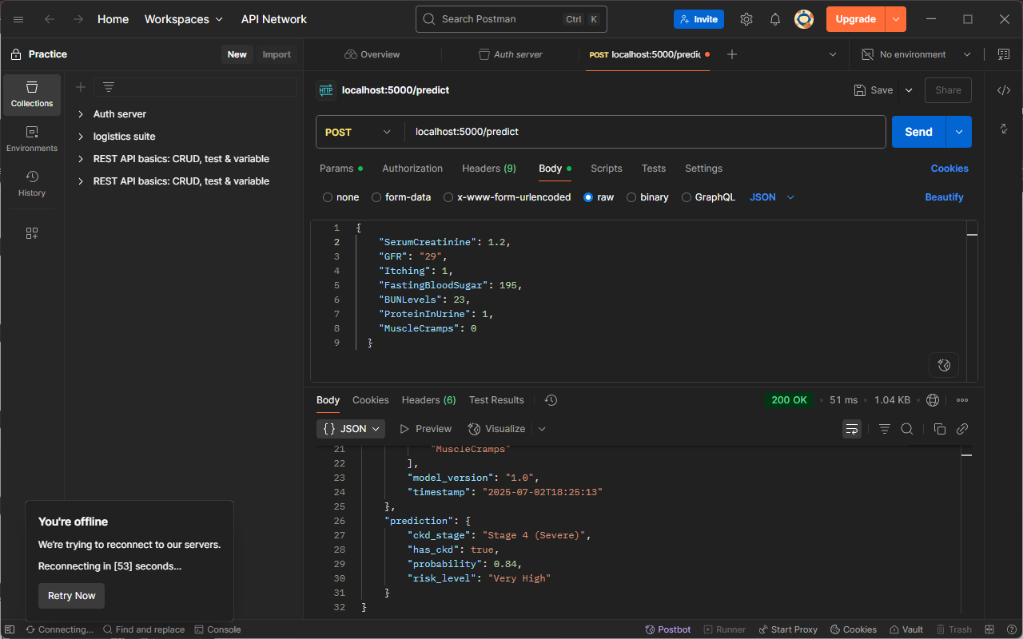

Slide 8
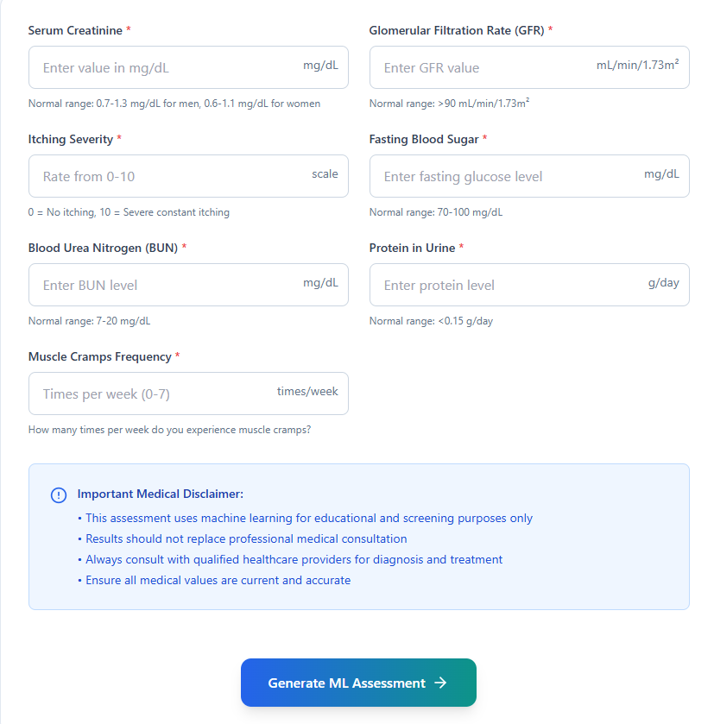

Slide 9
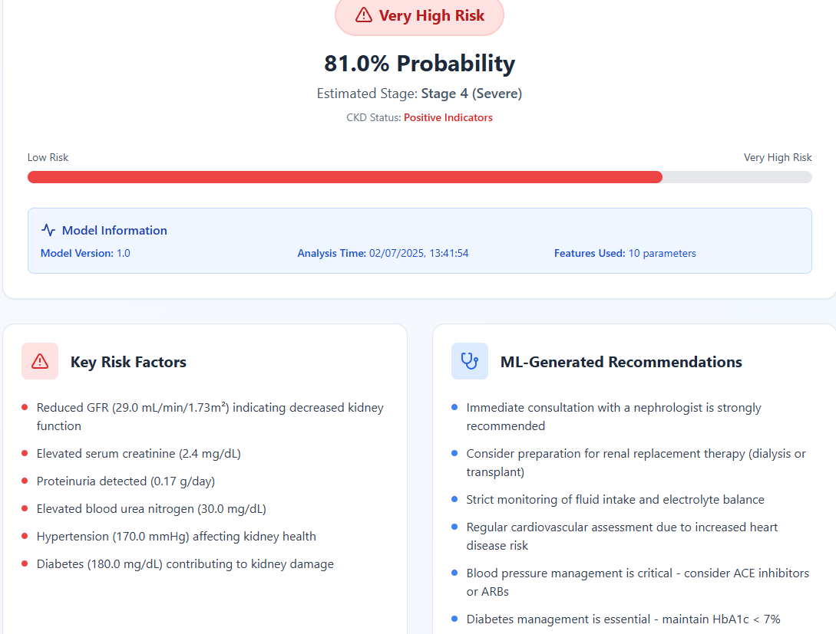

Slide 10
Reflections
Use of foreign data: More research needed in our region of the world to get accurate data as regarding our race and climate region
Dataset is more clinically oriented and will be more useful for clinicians rather than patients, a more patient centered dataset will be needed to train a model more suitable for patients

Slide 11
Thank you

